Slide 1
Clustering & Description
Maternal Mortality Indicator
In Colombia
Updated on July 10, 2020
By Andrés Segura

Slide 2
Clustering
K-Means
By Departments
(32 Departments + 1 DC + Exterior)

Slide 3
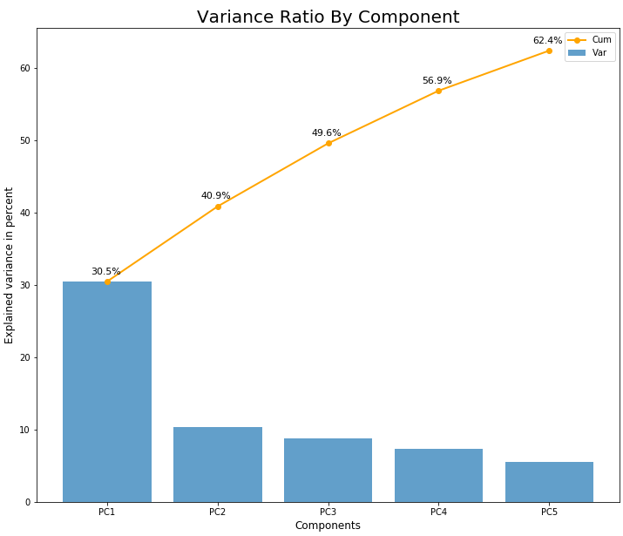
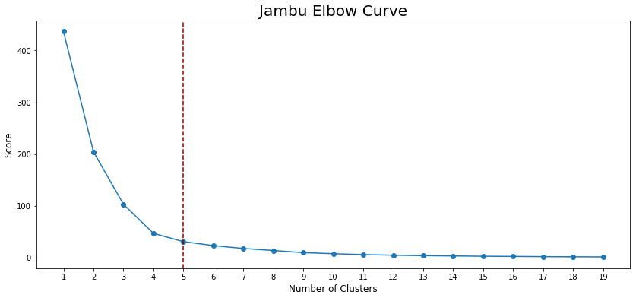
Dimensionality reduction: PCA
Variance by PCs
40.9 % with 2 PCs
49.6 % with 3 PCs and + 8.7 %
56.9 % with 4 PCs and + 7.3 %
62.4 % with 5 PCs and + 5.5 %

Slide 4
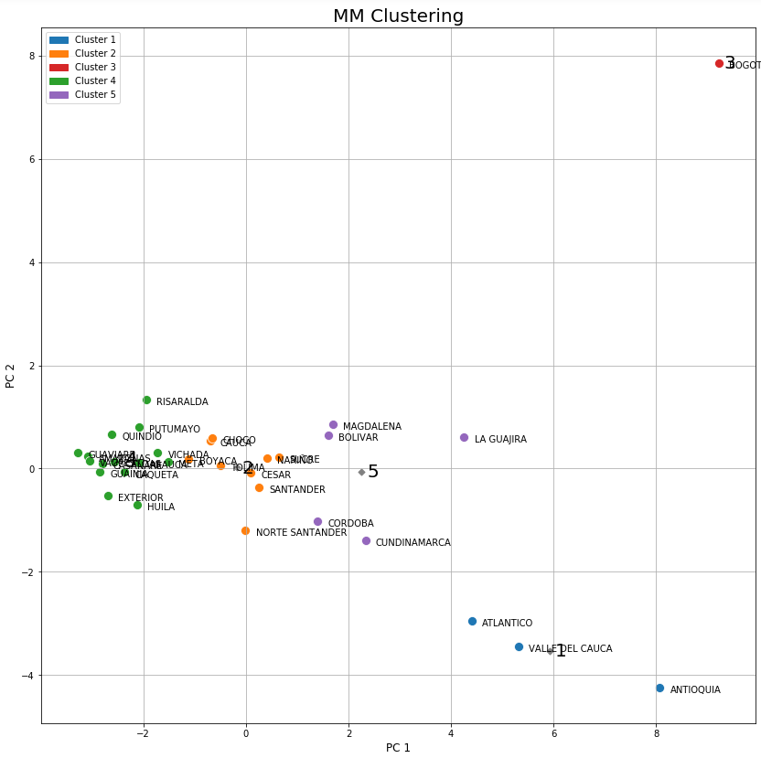
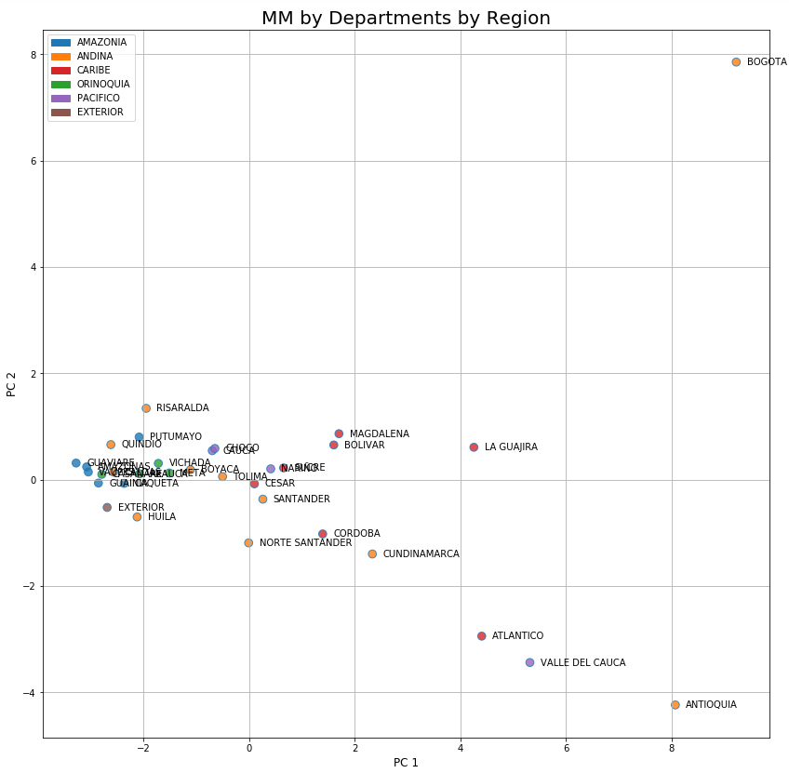
Clustering: K-Means vs Regions
5 clusters = 5 regions

Slide 5
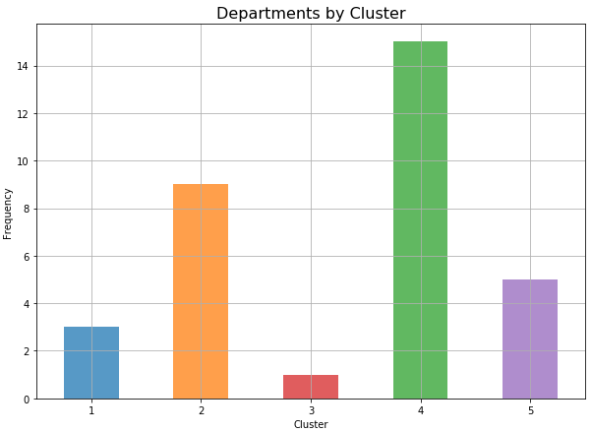
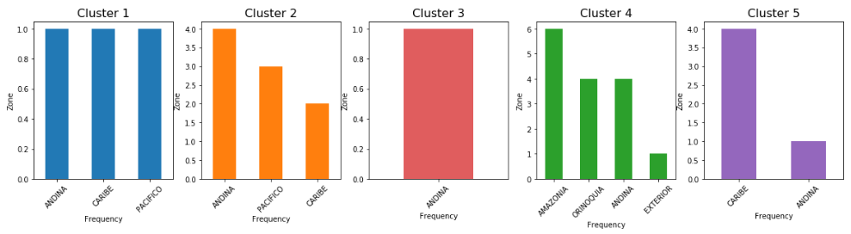
Clusters by Regions
Cluster 1 => {'ANDINA': 1, 'CARIBE': 1, 'PACIFICO': 1}
Cluster 2 => {'ANDINA': 4, 'PACIFICO': 3, 'CARIBE': 2}
Cluster 3 => {'ANDINA': 1}
Cluster 4 => {'AMAZONIA': 6, 'ORINOQUIA': 4, 'ANDINA': 4, 'EXTERIOR': 1}
Cluster 5 => {'CARIBE': 4, 'ANDINA': 1}

Slide 6
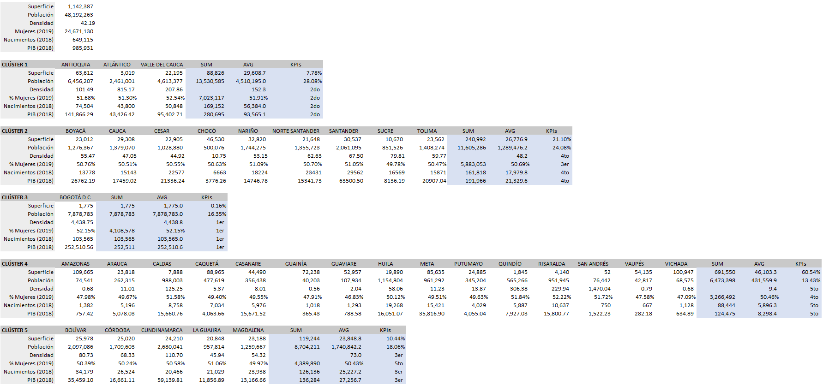
Departments Data
Sources: DANE and Wikipedia

Slide 7
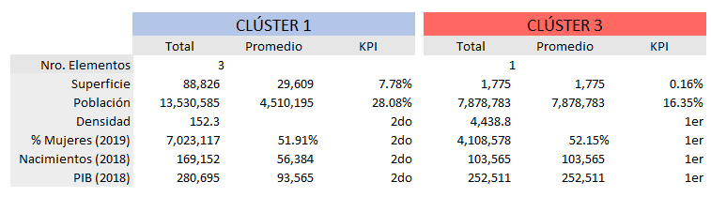
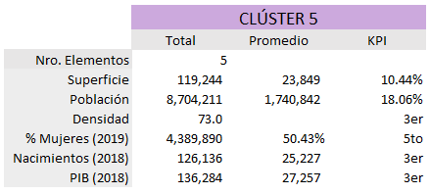
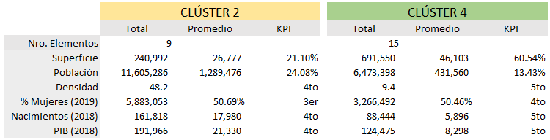
Understanding Clusters

Slide 8
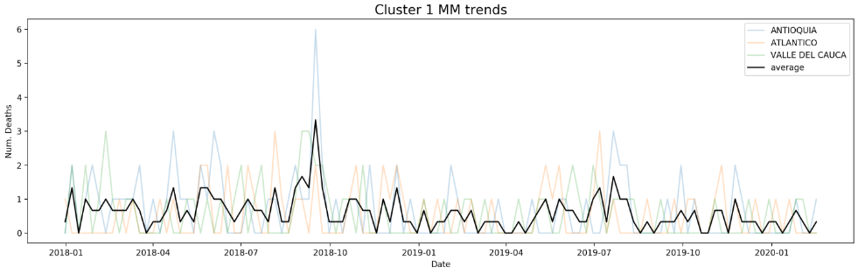
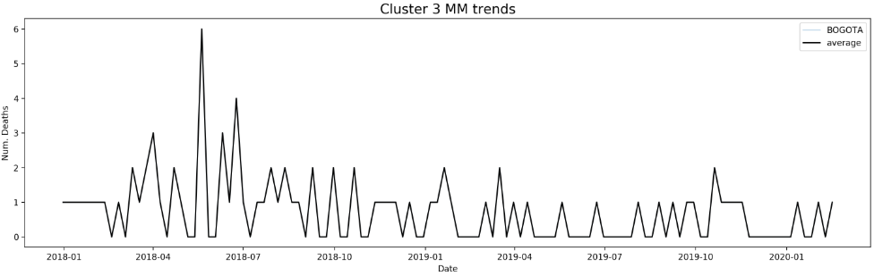
Clusters Trends

Slide 9
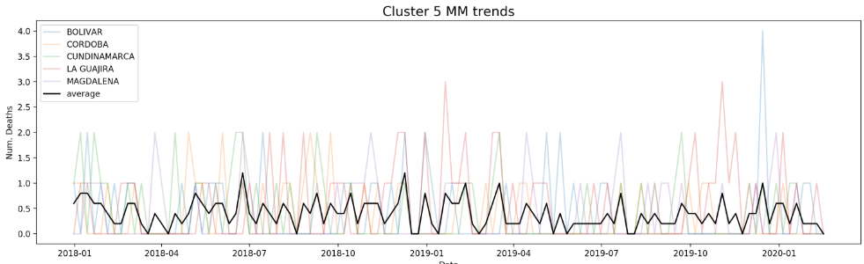
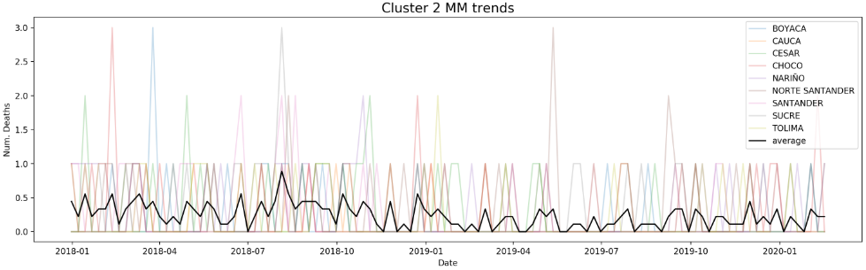
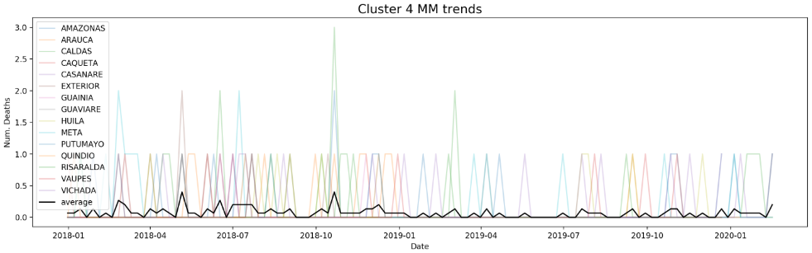

Slide 10
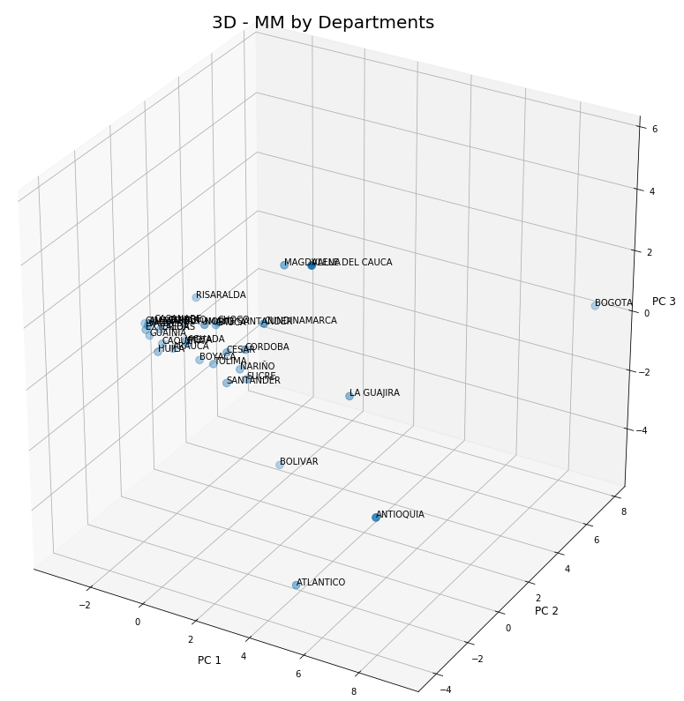
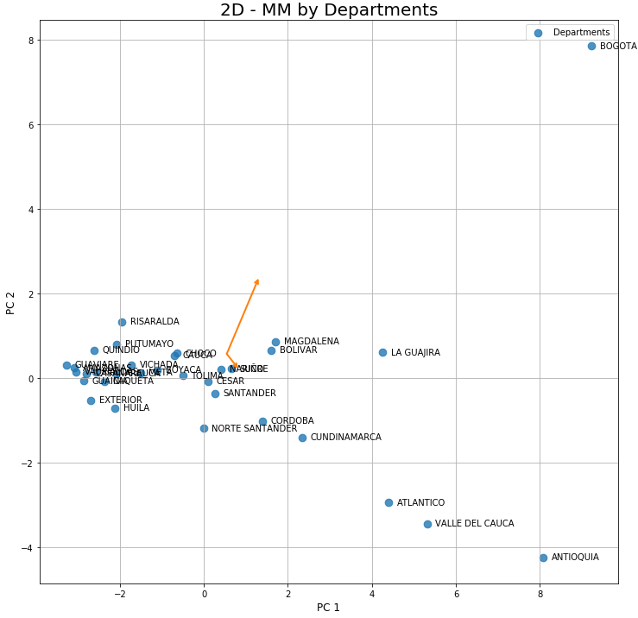

Clustering: Exploring other Params

Slide 11
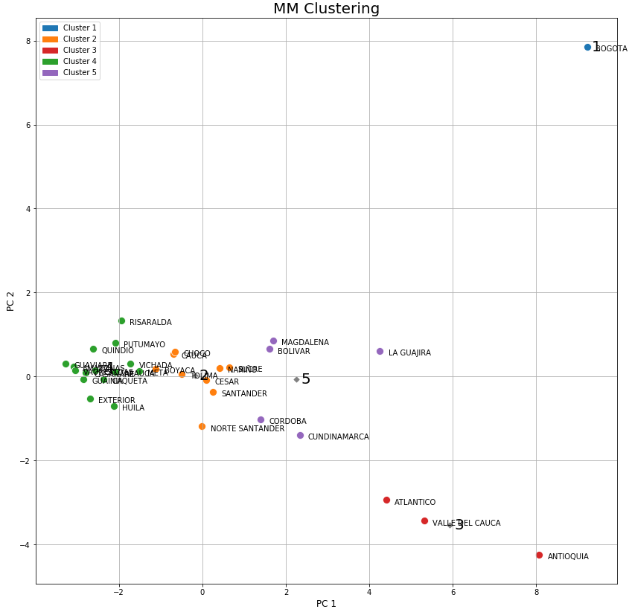
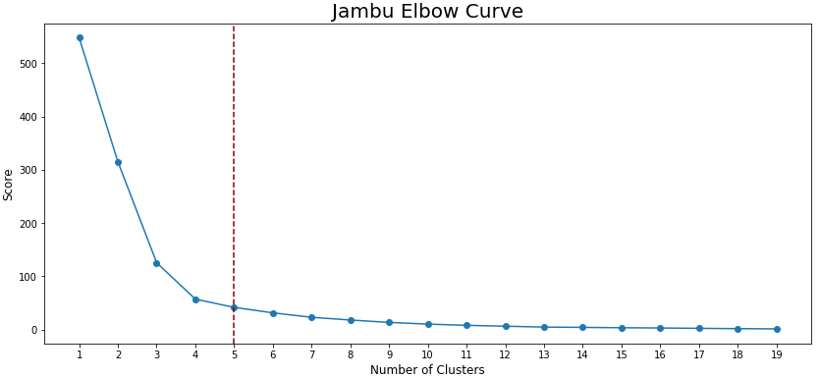
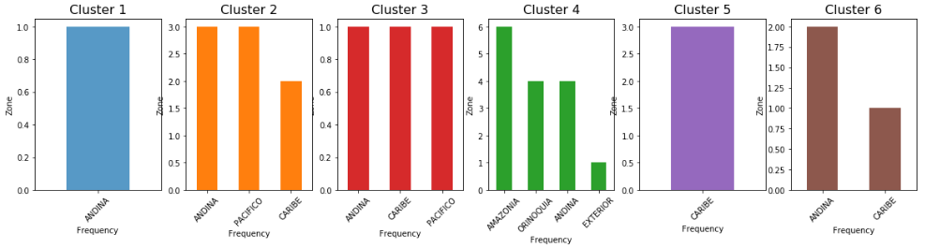
Clustering: Exploring other Params
3 PCs and 5 clusters

Slide 12
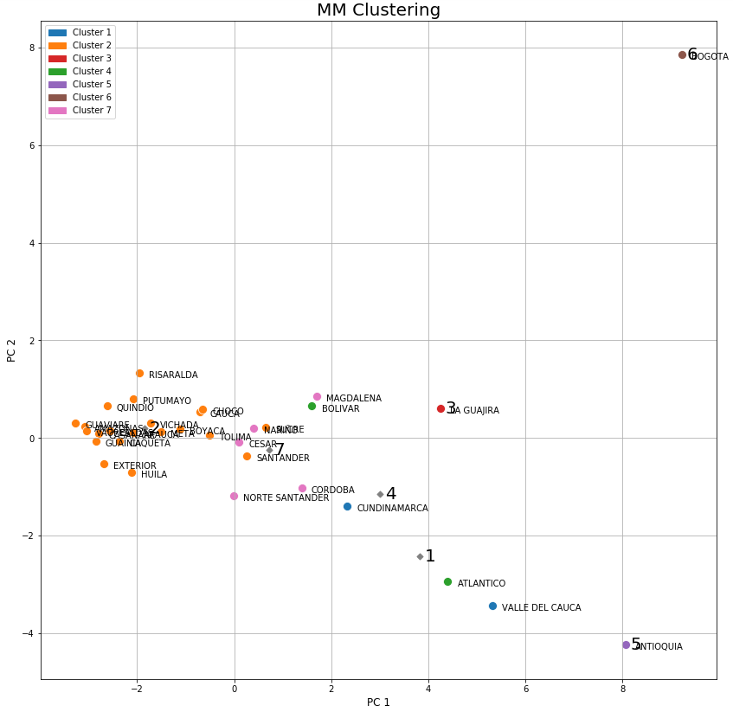
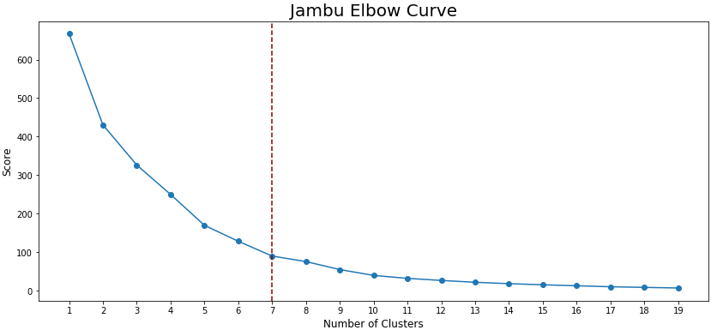
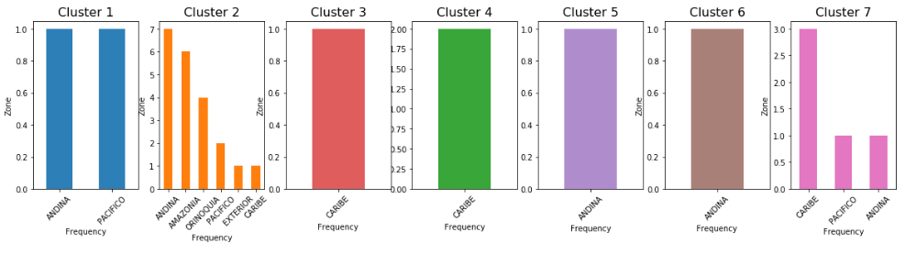
Clustering: Exploring other Params
5 PCs and 7 clusters

Slide 13
Let’s go to Jupyter Notebook…

